Slide 1
Module 13

Slide 2


RESPIRATION
phases
Now let us see
Cellular respiration
Also called as
Internal respiration
Breathing or External respiration

Slide 3
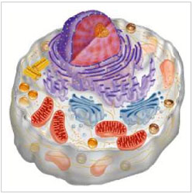


Cellular respiration
Inside the mitochondria
To produce
Glucose is oxidised
Energy
Mitochondria
Broken down by oxygen
ATP
Cell
It is a biochemical process
Inside the cell there is a organelle called as
Adenosine Tri Phosphate
Chemical process inside living cells

Slide 4
Let us see the steps of cellular respiration
Inside the cell
Glucose (which is a 6 carbon compound)
Glucose
C
C
C
C
C
C
Is broken down into
Pyruvate (which is a 3 carbon compound)
C
C
C
This step takes place in the cytoplasm
Pyruvate
This process is anaerobic.
Absence of O₂
It is called as glycolysis.

Slide 5
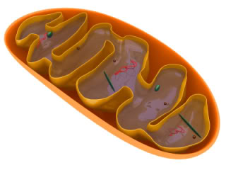

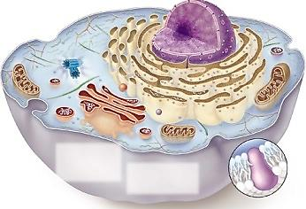
Now pyruvate enters the mitochondria
Here pyruvate is broken down in the presence of oxygen to release energy in the form of ATP.
CO₂ and H₂O are given out as by products.
Pyruvate
C
C
O₂
C
CO₂
H₂O
38 ATP

Slide 6
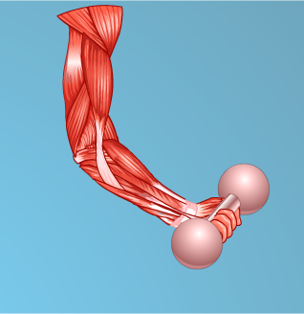
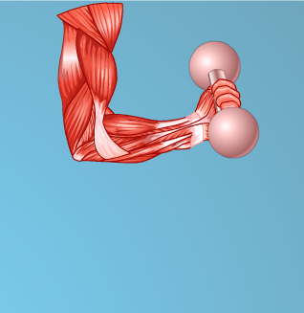
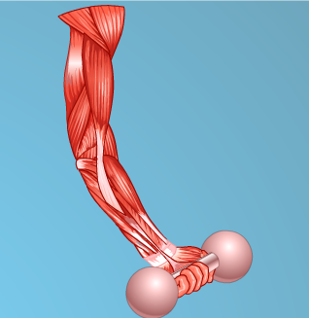
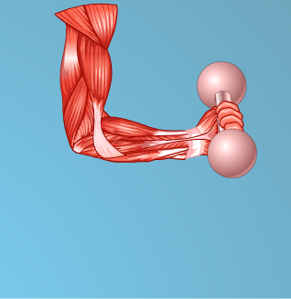
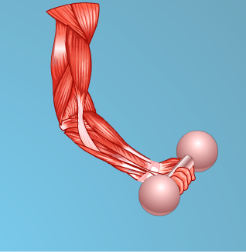

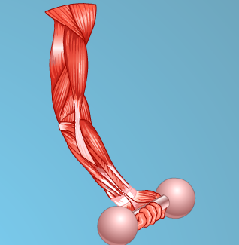
However during heavy exercise, the human muscle cells respire in the lack of oxygen.
So in the muscle cells pyruvate is broken down in the lack of oxygen to release energy (2 ATP).
Here lactic acid is formed as a byproduct.
This lactic acid gets accumulated in the muscle cells.
Due to this, the muscles feels fatigued during exercise.
Pyruvate
C
C
C
C
C
C
C
C
C
C
C
C
C
C
C
Lactic acid
C
C
C
C
C
C
C
C
C

Slide 7
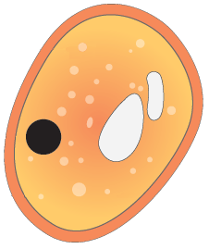
Organisms like yeast respire in the complete absence of oxygen.
So in case of yeast pyruvate is broken down in the absence of oxygen to release energy (2ATP).
Here, ethanol and carbon dioxide are formed as byproducts.
This process is called as fermentation.
Pyruvate
C
C
C
In the absence of oxygen
Ethanol
C
C
CO₂
Yeast

Slide 8
Thank You

